Slide 1


Dashboard for Video Game Sales
Students Name:
Tejas Bhandary (14)
Aaryan Chothani (20)
Atharva Dalvi (21)
Under the Guidance of Prof. Deepali Kayande

Slide 2
Introduction
Software companies, ranging from startups to industry giants, are inundated with vast amounts of data generated from various sources such as user interactions, system logs, financial transactions, and performance metrics.
The sheer volume and complexity of data pose significant hurdles in its effective management, analysis, and interpretation.
This project aims at providing a comprehensive and intuitive platform for data-driven decision-making and strategic planning.

Slide 3
Problem Definition
The influx of data, comprising various metrics, user feedback, operational statistics, and more, poses significant challenges in terms of efficient management, analysis, and utilization.
Conventional data tracking tools often fall short in accommodating the vast and dynamic nature of this data, making it challenging for companies to derive meaningful insights and make informed decisions in real-time.
An interactive dashboard emerges as a viable approach to tackle these challenges effectively.

Slide 4
Objectives
Develop a website involving an Interactive Dashboard
Develop a Data Management tool within the website
Facilitate real-time data updates
Maintain a dataset in AWS RDS
Host the frontend of the website on AWS S3
Host the backend server on AWS Elastic Beanstalk

Slide 5
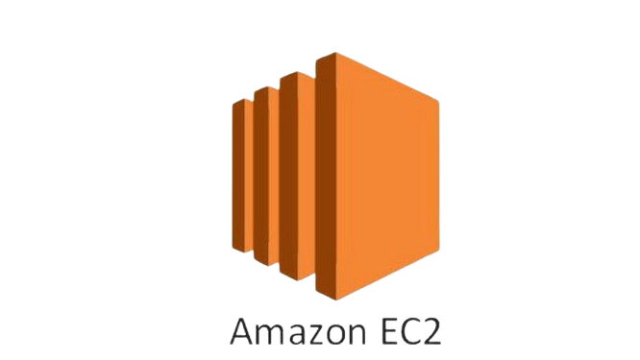



AWS Services Used

Slide 6
Implementation Details
Setting Up AWS Services:
• Set up Amazon RDS, S3 and Elastic Beanstalk
2. Database Setup and Management:
• Import the sales dataset into the MySQL database and configure security groups and permissions
• Connect an EC2 instance to the RDS database for management tasks.
3. Backend Development:
• Develop the Express.js backend application
• Connect to the MySQL database using RDS credentials.

Slide 7
Implementation Details
4. Frontend Development:
• Develop the React.js frontend application.
• Configure HTTP requests to communicate with the Express backend.
5. Integration and Deployment:
• Package the frontend files and upload them to the S3 bucket.

Slide 8
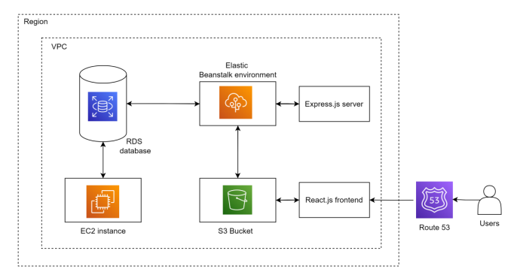
Architecture Diagram

Slide 9
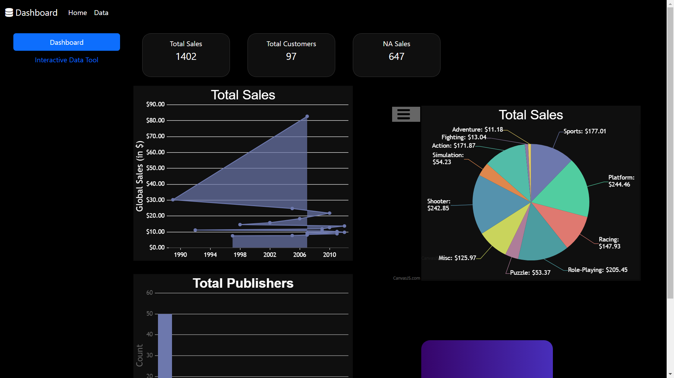
Results
Main Dashboard Page

Slide 10
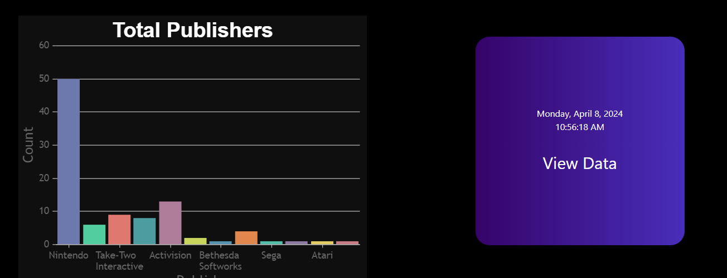
Results
Dashboard Sections

Slide 11
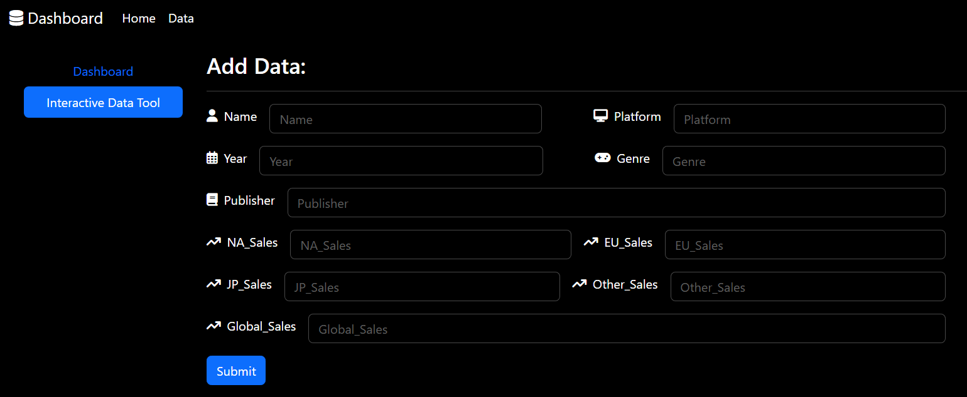
Results
Insert Data Section

Slide 12
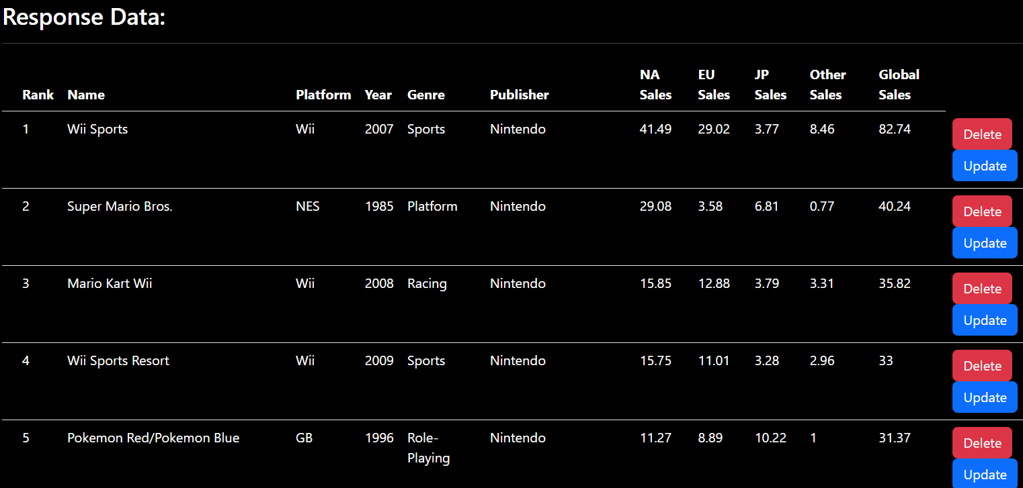
Results
Interactive Data Management Tool

Slide 13
Thank You!

